Slide 1
Examination of Volt-VAR Optimization with GridLAB-D

Slide 2
Presentation Overview
Part 1: Overview of Volt-VAR optimization and what is necessary for a proper evaluation.
Part 2: Implementation of Volt-VAR Optimization schemes in GridLAB-D.
Part 3: “Evaluation of Conservation Voltage Reduction (CVR) on a National Level” a PNNL report to the Department of Energy.
Appendix 1: uncoordinated methods of voltage control.

Slide 3
Part 1: Volt-VAR Optimization
Volt-VAR Optimization exists in many forms.
The general principle is to control the voltage and reactive power on a distribution feeder so that load can be managed.
  Voltage optimization involves “flattening” the voltage profile and possibly lowering the level.
  VAR optimization involves controlling the flow of reactive power, which has an impact on voltage.

Slide 4
Volt-VAR Optimization cont.
There are numerous Volt-VAR optimization options commercially available:
  General: Electric Coordinated Volt-VAR Control
  Cooper: Integrated Volt VAR Control
  ABB: Volt VAR Optimization
  PCS UtiliData: AdaptiVolt
Some support the operation of multiple regulators on a feeder.
There are also numerous academic papers on the topic. We will examine the following method:
  “V. Borozan, M. Baran, and D. Novosel, “Integrated Volt/VAR Control in Distribution Systems”, IEEE PES Winter Meeting, 2001.”

Slide 5
Time-variant Load Models
These are sometimes referred to as load profiles.
They can be fixed power values or time-variant ZIP models where ZIP coefficients change with time.
Often this information comes from measured data and is an aggregated value.
For CVR these are only appropriate for loads such as lights, fans, and other loads without a thermal cycle.

Slide 6

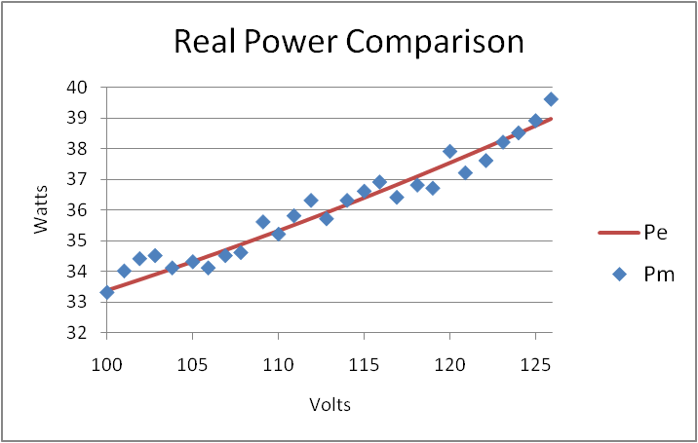
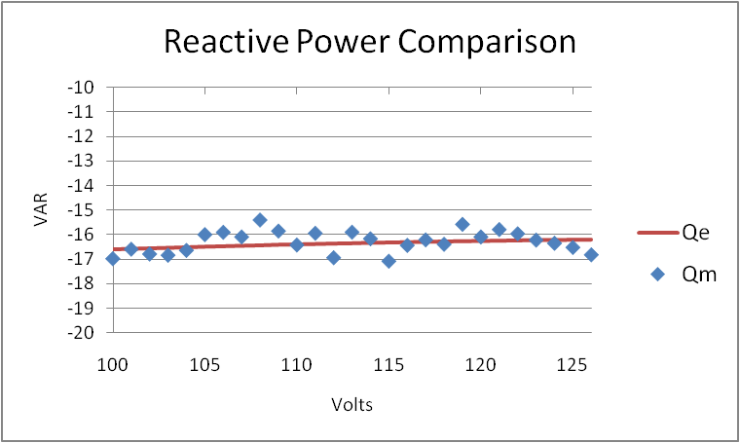
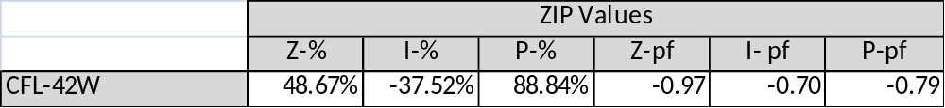
CFL Bulb

Slide 7
Physical Load Models
Physical load models are based on a physical process.
Processes can include: HVAC, energy storage, and thermal processes.
Time-variant in nature.
Can be significantly more complicated than ZIP models.
Provide the detail necessary to examine the actual behavior of end use loads.
For CVR these models must be used for any load with a thermal cycle.

Slide 8
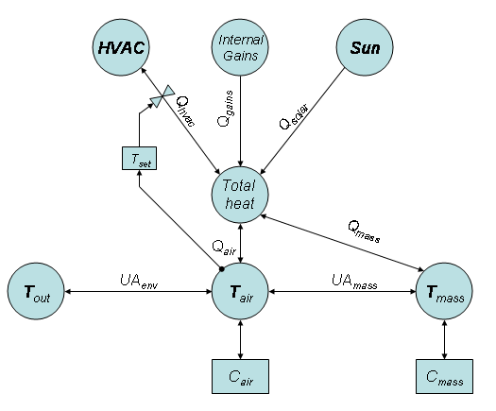
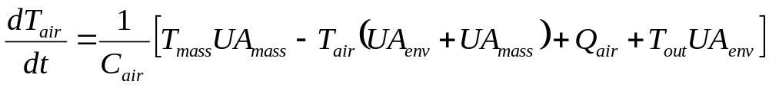
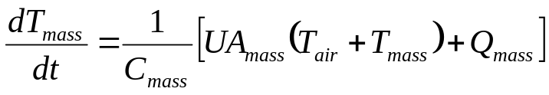
Physical Load Model – Residential HVAC System HVAC

Slide 9
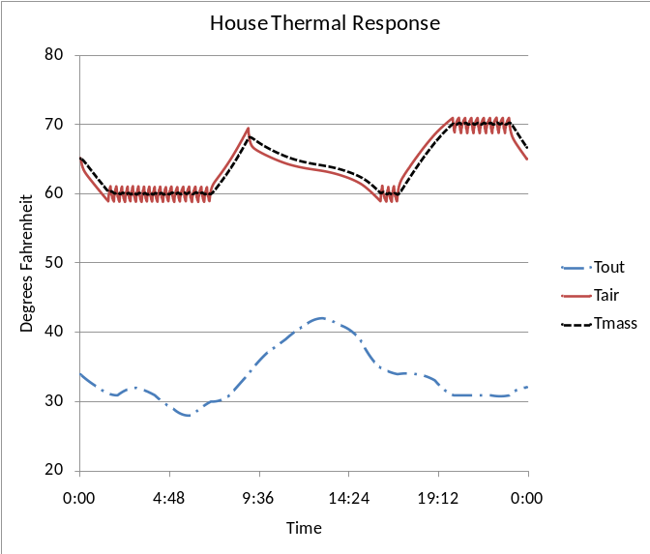
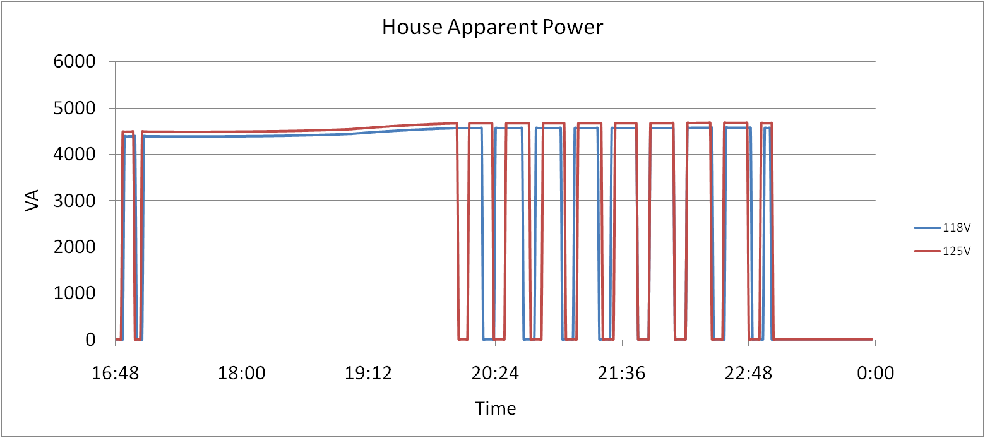
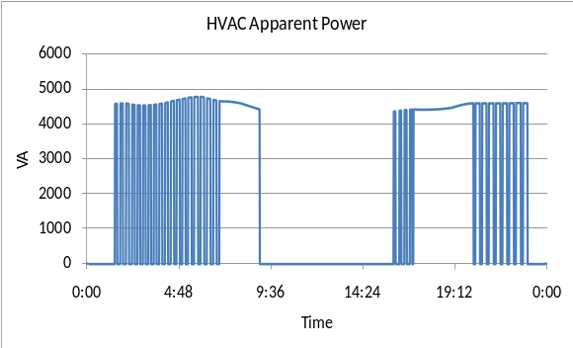
Physical Load Model – Residential HVAC

Slide 10
Part 2: Implementation of Volt-VAR Optimization GridLAB-D
Openly available CVR controller
General Electrics proprietary CVVR controller

Slide 11
Integrated Volt/VAR Control in Distribution Systems
This is an openly available Volt-VAR control system that has been implemented in GridLAB-D.
V. Borozan, M. Baran, and D. Novosel, “Integrated Volt/VAR Control in Distribution Systems”, IEEE PES Winter Meeting, 2001.
It is composed of 2 coordinated goals.
  Voltage reduction
  VAR control

Slide 12
Integrated Volt/VAR Control in Distribution Systems
Object Code
object volt_var_control {
name CVVC;
control_method ACTIVE;
capacitor_delay 60.0;
regulator_delay 60.0;
desired_pf 0.98;
d_max 0.8;
d_min 0.1;
substation_link “Reg1";
regulator_list “Reg1";
capacitor_list “CAP1,CAP2";
voltage_measurements “652,680";
maximum_voltages 3500;
minimum_voltages 2000;
max_vdrop 50;
high_load_deadband 30;
desired_voltages 2401;
low_load_deadband 30; }
Regulator operations are primary.
  Multiple measurement points can be listed for the regulator.
  “desired_voltage” sets the regulating voltage.
Capacitor operations are secondary.
  The capacitors operated based on the reactive power flow on a single line.
  “substation_link” sets the line on which reactive power is regulated.

Slide 13
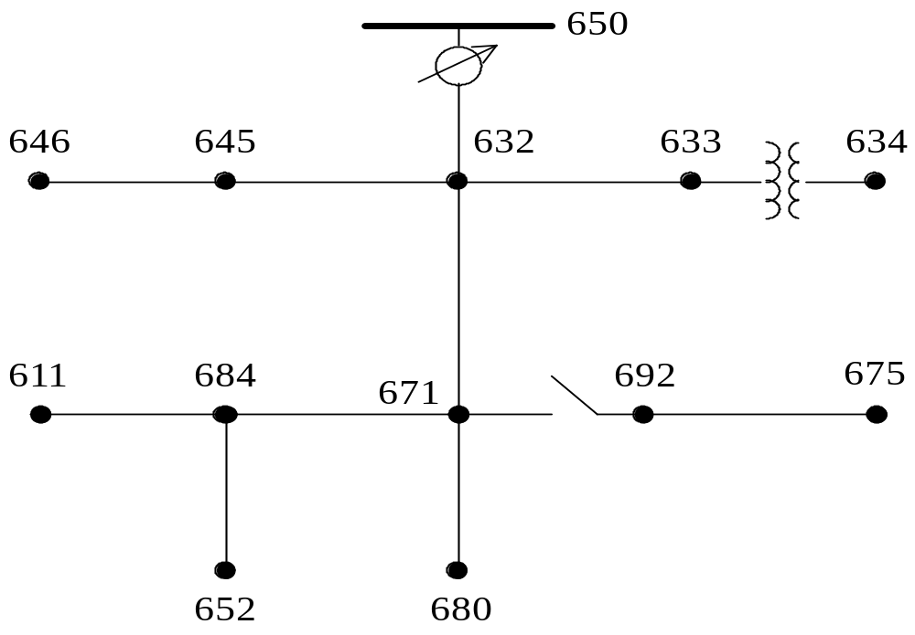
Modified IEEE 13 Node System with Volt-VAR Control
VAR Controlled Link
EOL Measurements

Slide 14
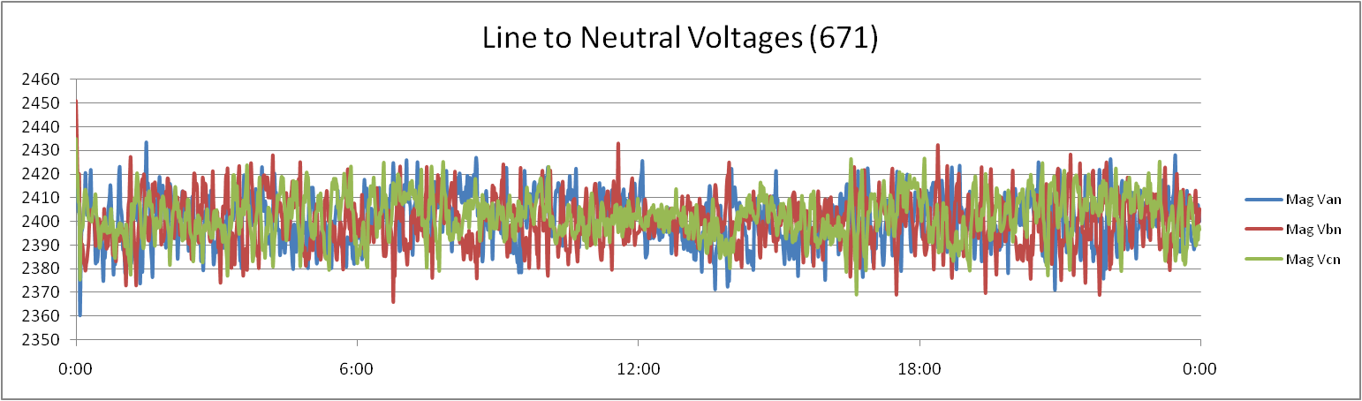
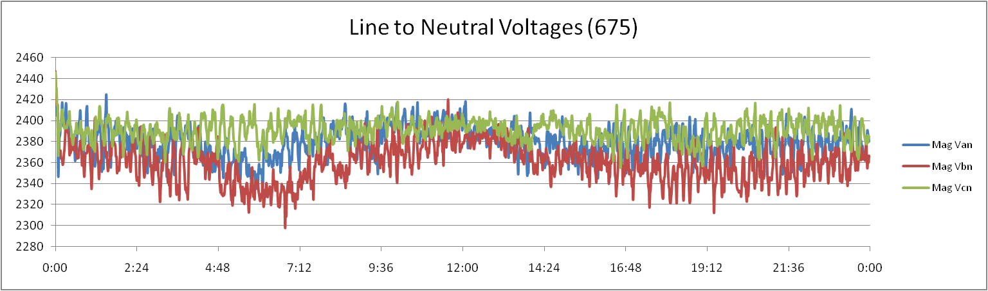
Case 1: Local Voltage Control
Voltage at node:671 is controlled by regulator to 2,400V:
Voltage at node:675 is maintained by capacitors:

Slide 15
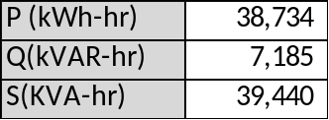
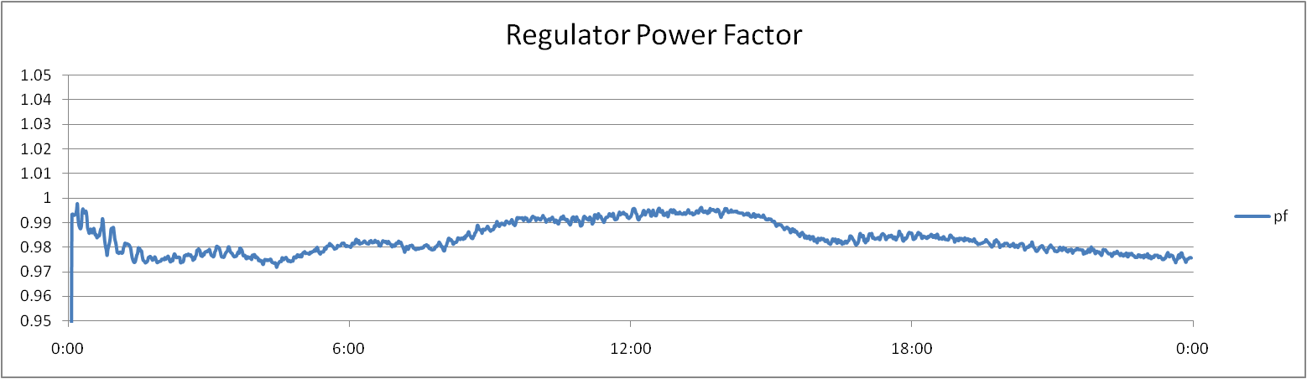
Case 1: Local Voltage Control cont.
Voltage is still operated at an upper level. As a result, there are energy reductions that are not realized.
Power factor is not maintained:

Slide 16
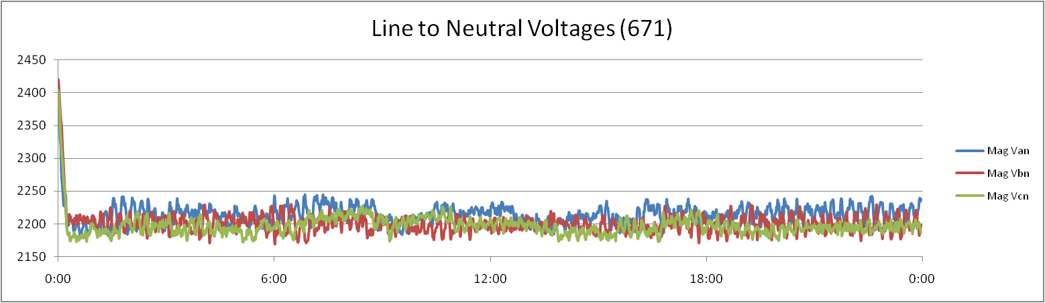
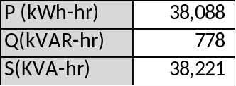
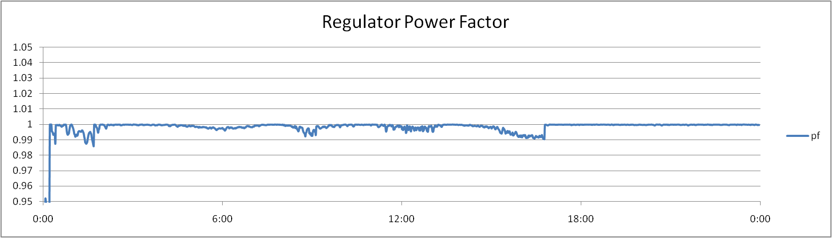
Case 2: Coordinated Volt/VAR Control
Voltage is regulated at remote nodes 652 and 680, to a values of 2,200V:
Energy consumption is reduced:
Power factor is maintained

Slide 17
Exercise 1
Run the CVR 13 Node system for 7 days.
Use the CVR 13 Node system and determine the real and reactive energy consumption, as well as power factor for the following cases:
  CVR in STANDY
  CVR regulating to 2400
  CVR regulating to 2300
  CVR regulating to 2200
Is the voltage properly regulated at the EOL nodes?
Is the power factor properly corrected?
Why is the load steadily increasing over the seven day period?

Slide 18
Exercise 2
Run the CVR 13 Node system for 7 days.
Use the CVR 13 Node system to determine if the default EOL measurements are correct.
Are there nodes with lower voltages?
What are the optimal EOL points?

Slide 19
General Electric Proprietary Coordinated Volt-VAR Controller
This information is covered by a Non-Disclosure Agreement. Contact General electric for more information on this product.

Slide 20
Part 3: PNNL CVR Report
This report was prepared at the Pacific Northwest National Laboratory for the Department of Energy Office of Electricity.
It examined the potential benefits of deploying CVR on a national scale.
It utilized an openly available method: V. Borozan, M. Baran, and D. Novosel, “Integrated Volt/VAR Control in Distribution Systems”, IEEE PES Winter Meeting, 2001.
A commercial product should have superior performance.

Slide 21
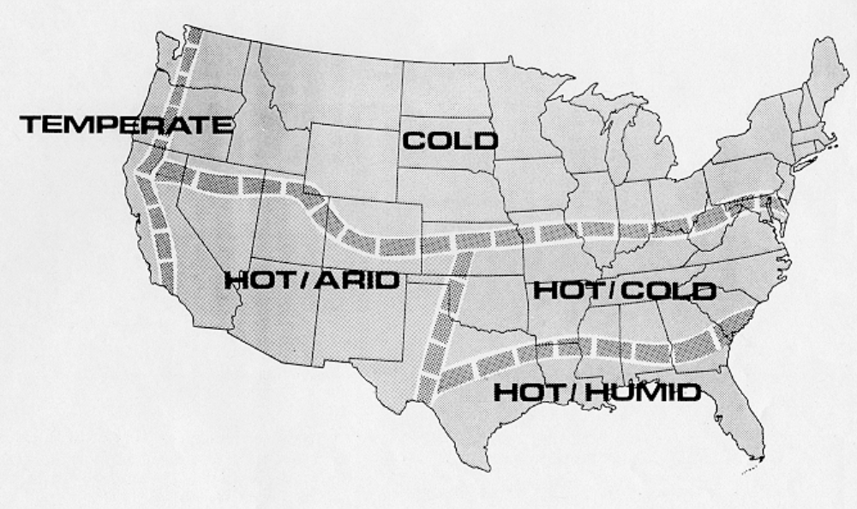
Climate Regions

Slide 22
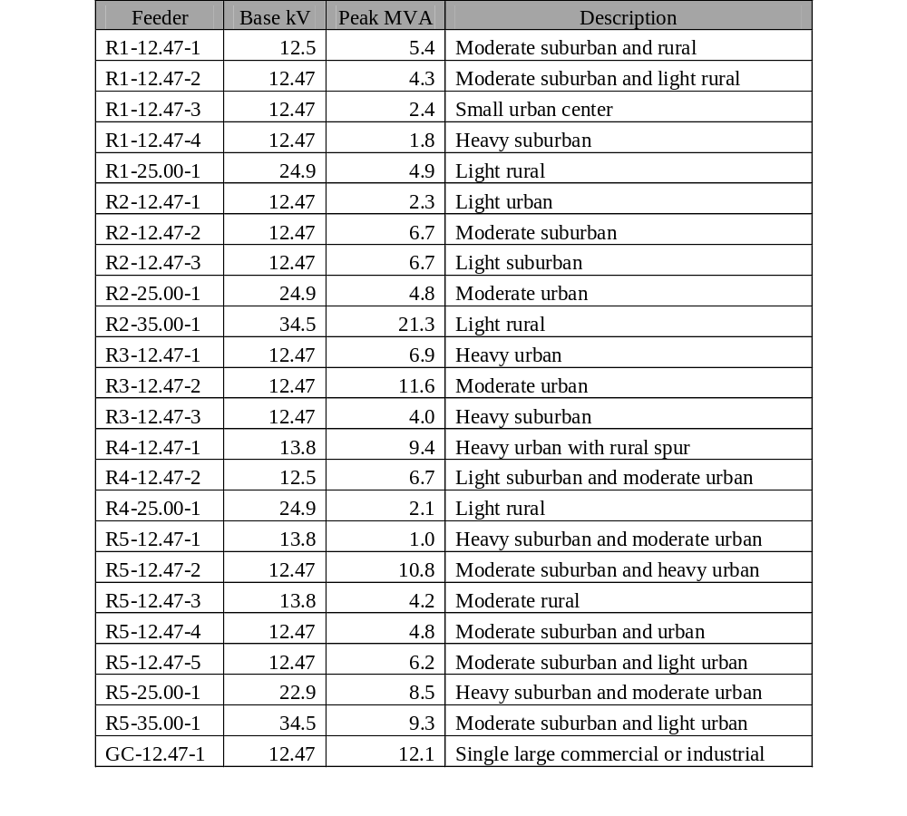
Prototypical Feeders
5 climate regions
3 general voltage levels
  12.47
  25.00
  35.00
23 regional feeders
1 general commercial feeder

Slide 23
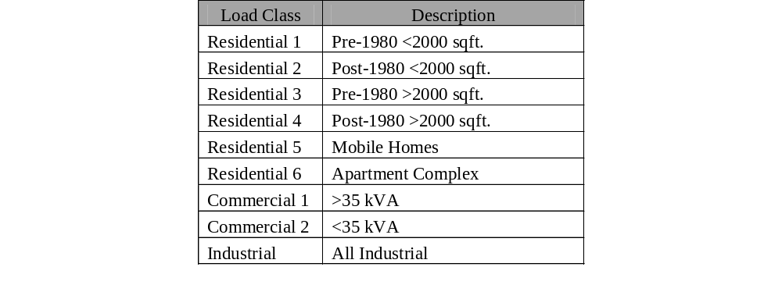
Load Classifications
6 Residential classifications
2 Commercial classifications
1 Industrial classification

Slide 24
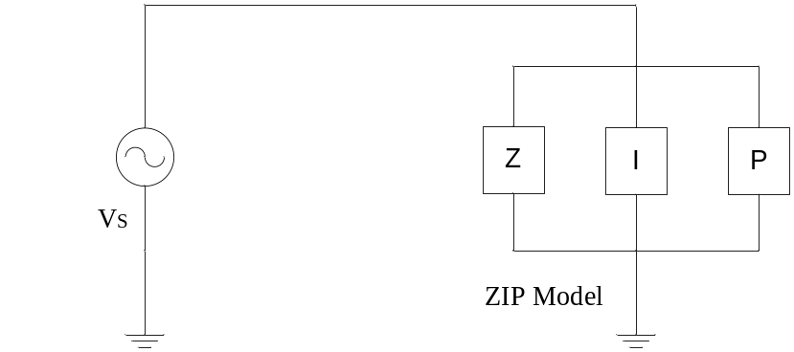
Load Models
ZIP Models
Physical Models

Slide 25
Results
Results were generated for each of the 24 feeders.
  Annual energy reduction
  Peak load reduction
Results for individual feeders were then scales up to a national level.

Slide 26
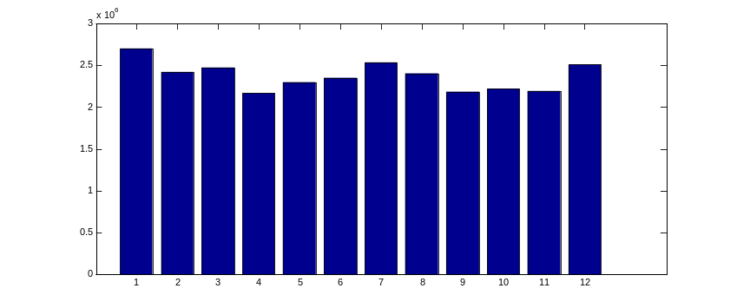
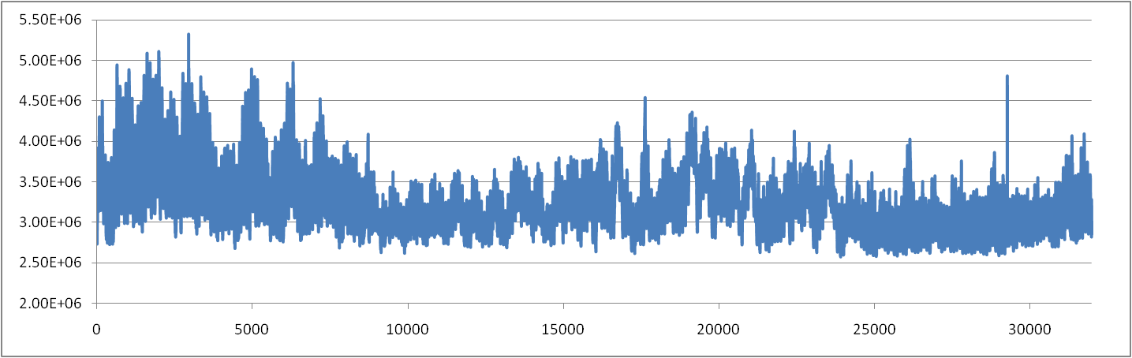
How to Examine Results
Time series power consumption
Monthly energy consumption
Converting the raw time series data into useable engineering information is extremely important.
  Annual values
  Monthly values
  Averages

Slide 27
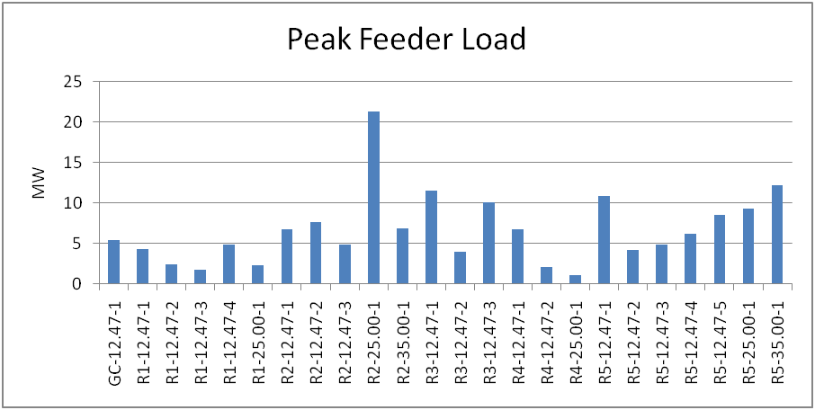
Peak Feeder Load

Slide 28
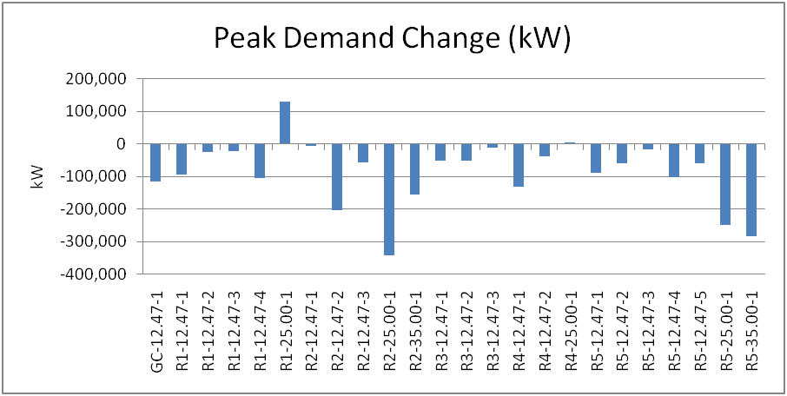
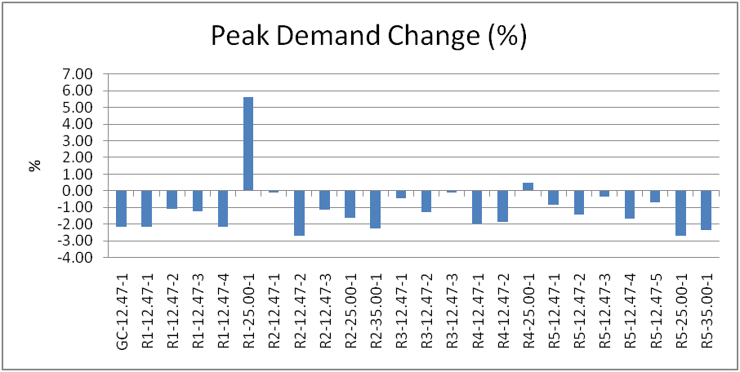
Peak Demand Change

Slide 29
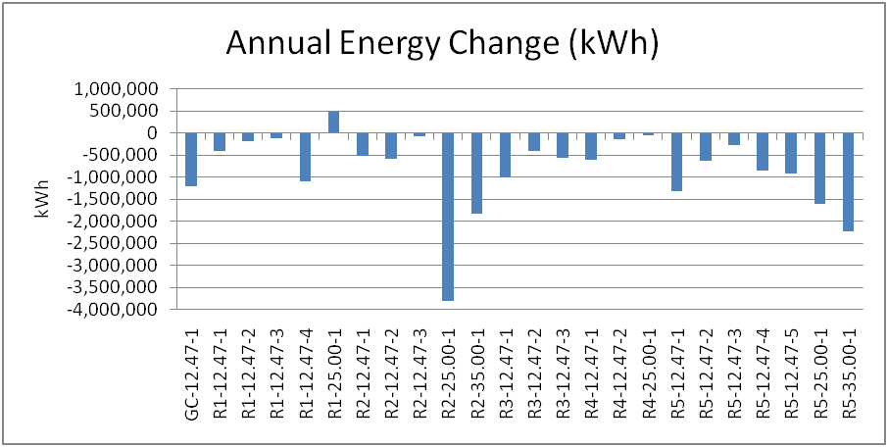
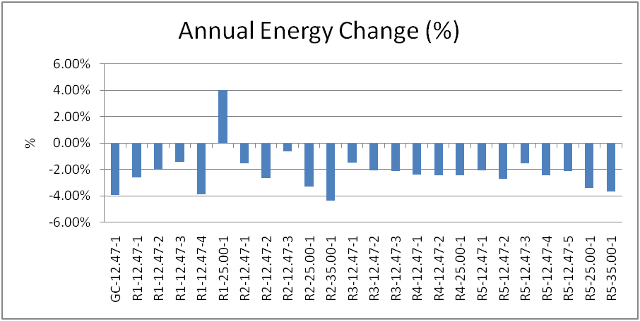
Annual Energy Change

Slide 30
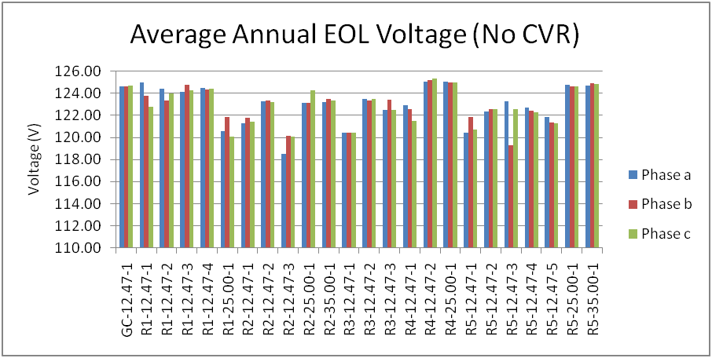
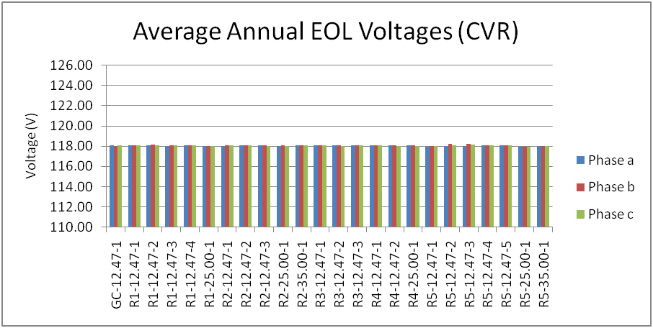
EOL Voltage Levels

Slide 31
What is Examined on a Single Feeder
Examine change in Total Energy
  Real power as measured at the regulator (phase a, b, and c)
Examine change in Total Load
  Real power as measured at the residential meters
  Real power as measured at the commercial meters
  Real power as measured at the industrial meters
Examine change in Total Losses
  Overhead lines
  Underground lines
  Transformers
  Triplex lines

Slide 32
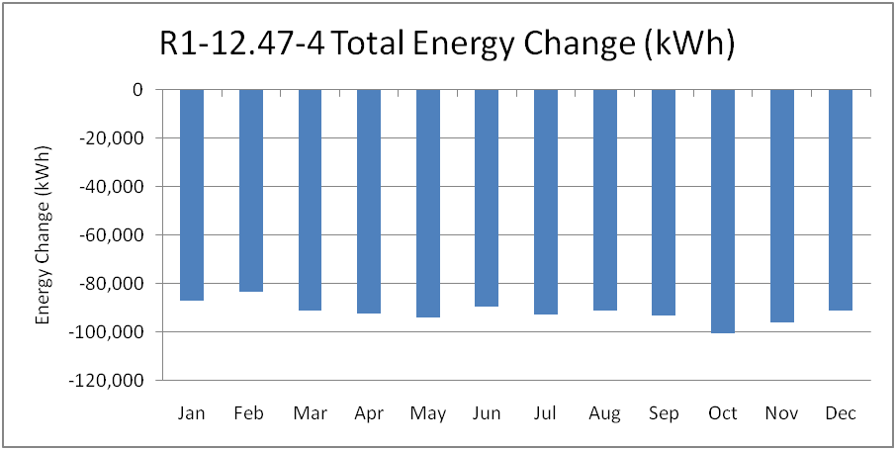
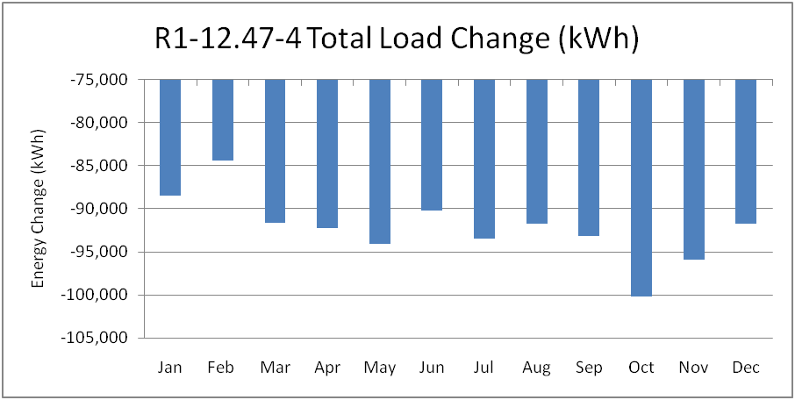
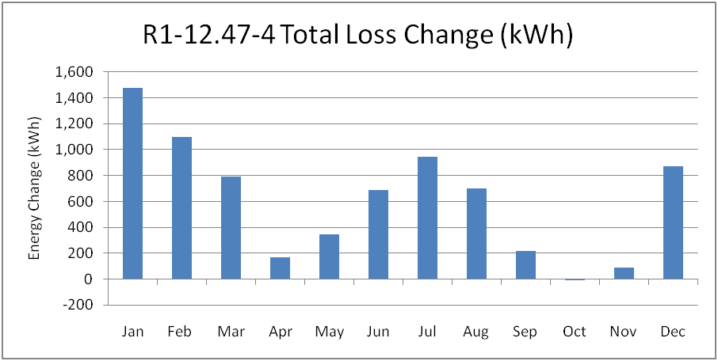
R1-12.47-4 Results (kWh)

Slide 33
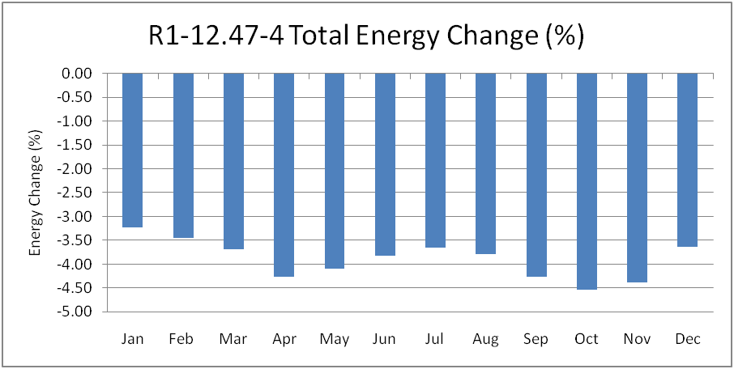

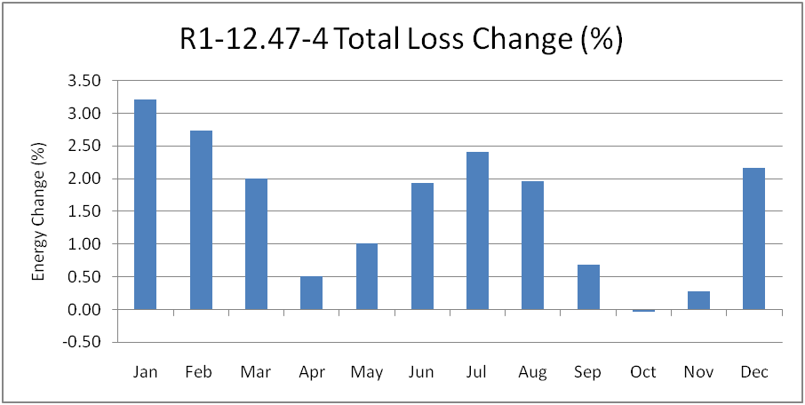
R1-12.47-4 Results (%)

Slide 34
R1-12.47-4 Results cont.
Energy consumption of the loads decreased while losses increased.
Overall the implemented CVR strategy reduced total energy consumption of this particular feeder.
The effectiveness of CVR varied through out the year, appearing to be slightly more effective on shoulder months.
Fully understanding the effects of CVR require examination of loads, losses, equipment operations, and examination of voltage profiles.

Slide 35
EOL Voltage Levels
The benefits from CVR are subject to two issues.
  How much can voltage be reduced.
  How much load is affected by the reduction.
A large reduction in voltage can result in a small reduction of energy consumption if the feeder is lightly loaded.
A heavily loaded feeder may not be able to reduce it’s voltage also resulting in a small reduction in energy consumption.

Slide 36
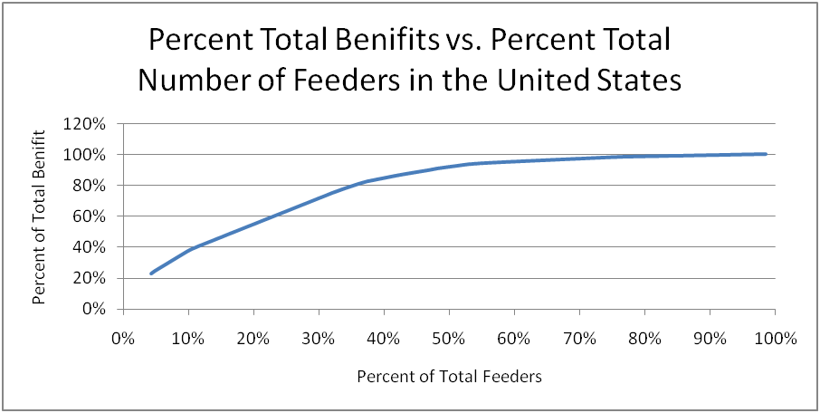
How Many Feeders to Deploy CVR On?

Slide 37
Report Concluding Remarks
This report has examined the benefits of deploying CVR and extrapolated those benefits to a national level. The CVR scheme implemented is 20 years old and is in the public domain, but newer proprietary methods are expected to provide improved results. The principle results obtained from this analysis are as follow:
The analysis of CVR, as well as other smart grid technologies, requires the use of time-series simulations.
The behavior of end use loads is more complicated than generally acknowledged. Voltage dependent multi-state models must be used.
CVR provides peak load reduction and annual energy reduction of approximately 0.5%-3% depending on the specific feeder.
When extrapolated to a national level it can be seen that a complete deployment of CVR, 100% of distribution feeders, provides a 3.04% reduction in annual energy consumption.
If deployed only on high value distribution feeders, 40% of distribution feeders, the annual energy consumption is still reduced by 2.4%.
In a practical deployment of CVR heavily loaded higher voltage feeders should be targeted.
Loss reduction is not a significant benefit of CVR.

Slide 38
Exercise 3
Install the necessary group IDs and collectors to be able to examine the impact of load and losses on the 13 Node system.
Run the CVR 13 Node system for 7 days.
How does the CVR scheme affect load and losses?

